Slide 1

SMOOTH DRIVE COLLEGE OF MOTORING
SUSHANT HUMAGAIN
RONISH SHRESTHA
SWAGAT NEUPANE

Slide 2
INTRODUCTION
Smooth drive college of motoring:
Specialized in providing driving lessons to the people of Scotland
Aims to cope with the ever-increasing paperwork and create smooth communication and sharing of information among offices in different cities.
Robust database system in place for critical information management

Slide 3
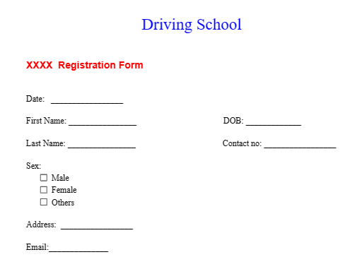
Database key operation
FORMS:
Student Registration
Employee information
Instructor
Course information
Vehicle and it’s maintenance
payment

Slide 4
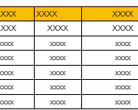
Database key operation
REPORT:
Student enrollment
Instructor performance
Student progress
Vehicle maintenance
Transaction report

Slide 5
ENTITY AND ATTRIBUTES
Office-officeID, location, no.of employee)
Student(StudentID (Primary key),First Name,Last Name,Address,Sex,Contact No,Email)
Employee(EmployeeID, firstName, LastName, contact information, Address, Position, DOB(date of birth, gender)
Instructor(Instructor ID, First Name, Last Name, Vehicle assigned, Vehicle ID, CourseName, Course ID, Availability, Qualifications, Specialities)
Course(CourseName, Course ID, InstructorID, studentID, Start Date, End Date, Duration, Level)
Vehicle(VehicleID, Vehicle Make, Vehicle Type, Model, Year, License Plate Number)
Maintenance(Vehicle Type, VehicleID, Date, Service Type, Service Provider, Service Cost, Next Schedule Maintenance )
Payment(Payment ID, Name, Date, Email, Amount, Payment Method)

Slide 6
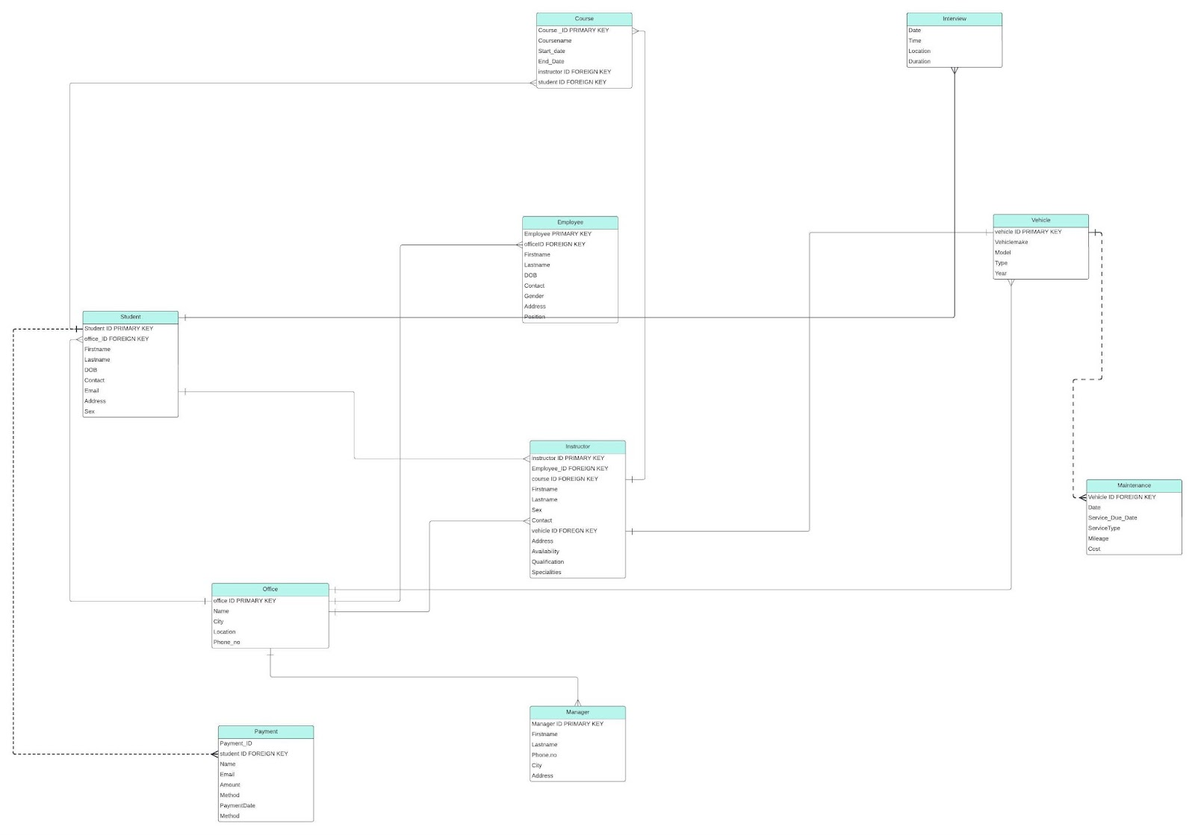
ER DIAGRAM

Slide 7

Establishment of relationship.
Primary Key
Foreign key
Relationship Cardinality
Referential Integrity

Slide 8

Benefits of ERD
Clear Communication
Visual Representation
Identifying Anomalies
Design Evaluation

Slide 9
Tables
Office
Employee
Student
Instructor
Course
Vehicle
Maintenance
payment

Slide 10

IMPORTANCE OF TABLES
Organize data
Data relationship
Efficiency
Data integrity

Slide 11
Normalization
Process used to make a database that will be free from anomalies like insertion, deletion, and update.
Ensure data is accurate, manage spaces, and make queries on the database run as fast as possible.
Normalized table up to BCNF
Creation of separate tables of tables to achieve BCNF

Slide 12

SQL QUERIES
SQL queries perform a variety of operations such as:
Data retrieval, insertion, update, deletion
Data aggregation
Data sorting
Data filtering
Subqueries and join

Slide 13

THANK YOU

